Slide 1
Miklošič dictionary Old Slavonic – Greek / Latin Dictionary (Lexicon Palaeoslovenico – Graeco-Latinum) Etymology tagging issues
Dr. sc. Martina Kramarić

Slide 2
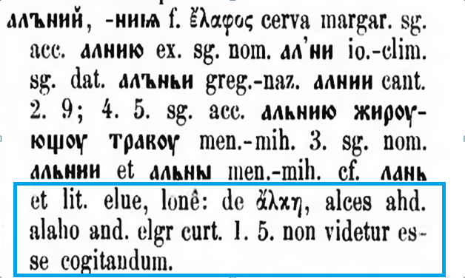
Starting point

Slide 3
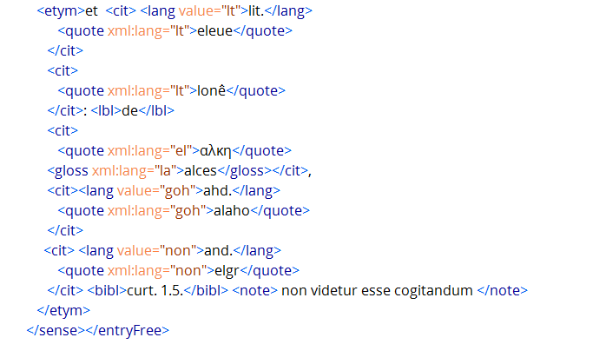
TEI solution

Slide 4
Thank you!

